Slide 1

CS 470 Project Two Conference Presentation: Cloud Development
Laura Pittman
April 2025
Notes:
Hello! My name is Laura Pittman, and I am a senior in my last term at Southern New Hampshire University working on my bachelor’s degree in Computer Science.

Slide 2
Overview
Cloud development
Migrating a full stack application to an AWS serverless solution
Notes:
This presentation will assess and discuss the intricacies of cloud development, specifically the process of migrating from a full stack application to a cloud-native web application using AWS microservices, in a way that is easily understood by both technical and non-technical audiences.

Slide 3
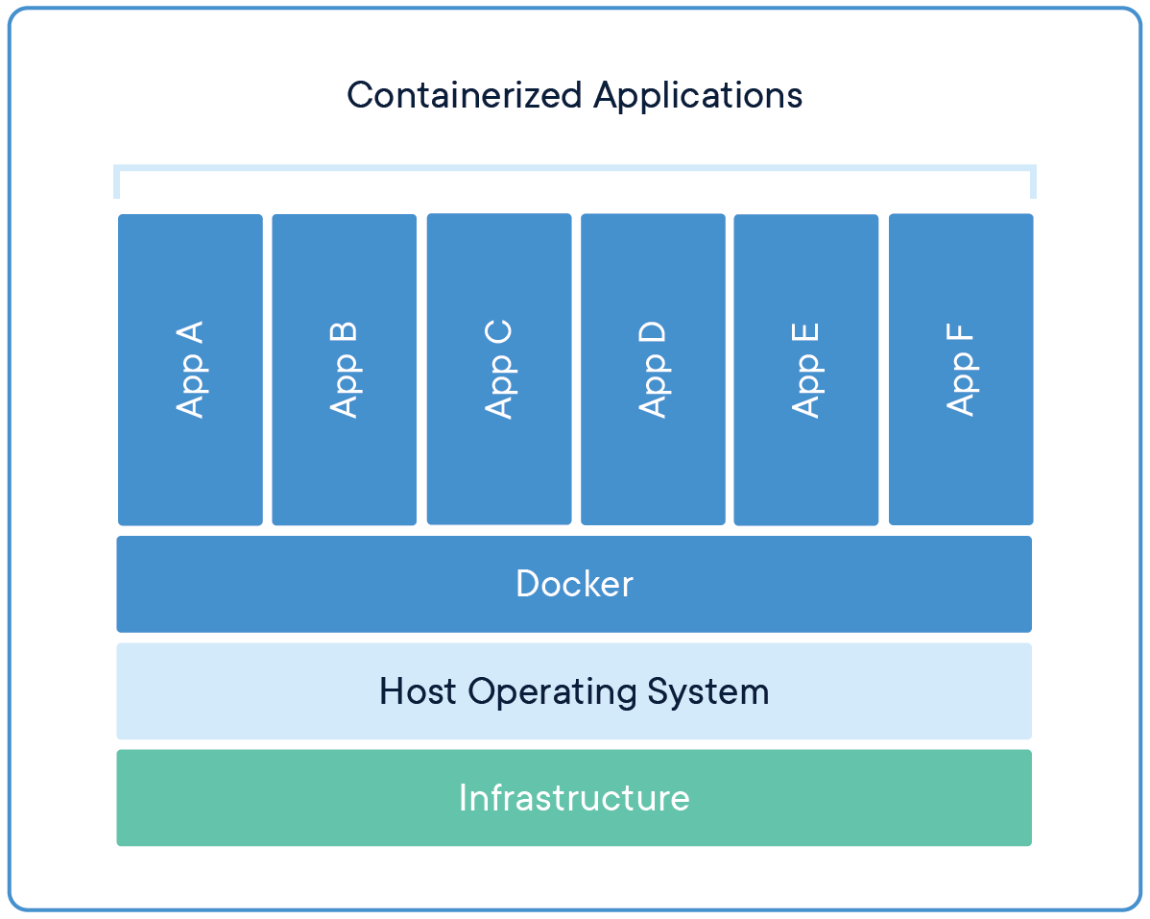
Containerization
Model: Replatform
Tools: Docker and Docker Compose
Application Parts: Frontend, Backend, and Database
Docker Inc. (2025). Containerized Applications. Docker. Retrieved from https://www.docker.com/resources/what-container/.
Notes:
The model used to migrate the full stack application to the cloud was replatforming which included making very minimal changes to optimize it for the cloud platform and updating the application's database and other dependencies to cloud-native versions. Docker and Docker Compose are necessary tools for this task as they allow for containerization. This is the process that allows the original application to be broken down into smaller parts like the frontend, backend, and database and packaging each part into a separate container that can later be deployed to the cloud.

Slide 4
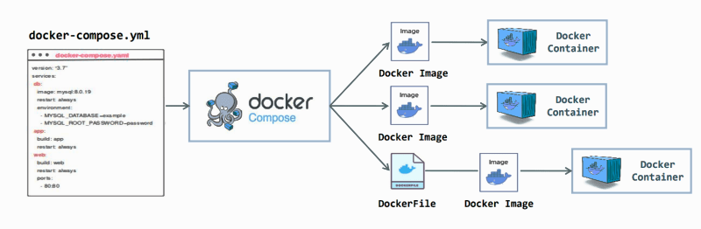
Orchestration
Docker Compose allows for containerization and management of multi-container applications
Sohail, J. (2024). Docker Compose. DevOps.dev. Medium. Retrieved from https://blog.devops.dev/what-and-why-of-docker-compose-dc95314c74b8.
Notes:
The value of using Docker Compose is unmatched as it necessary to make the management of multi-container Docker applications even easier. It allows you to define and run multiple services in a single configuration file, also known as docker-compose.yml. This process makes it much easier to manage dependencies, environments, and scaling if needed.

Slide 5
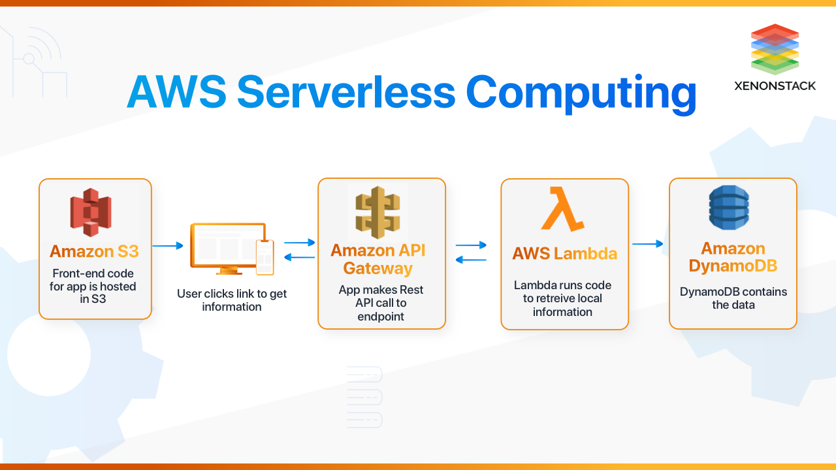
The Serverless Cloud
Serverless
Cloud computing model
No server management
Authentication with JSON Web Tokens (JWT)
S3 storage is a cloud-based object storage
Gill, J. K. (2025). AWS Serverless Computing. XenonStack. Retrieved from https://www.xenonstack.com/blog/aws-serverless-computing/.
Notes:
Serverless computing is a cloud computing model that eliminates the need for users to manage and provision servers as they are monitored by another entity, for this particular instance that is AWS. This type of application has various advantages such as no need to maintain or provision servers, authentication through JSON Web Tokens which are a compact and self-contained way for securely transmitting information by verifying the client's credentials and what actions they are allowed to perform. Furthermore, S3 storage is a cloud-based object storage built to retrieve any amount of data from anywhere that offers scalability, data availability, security, and performance, and it is rather different from local storage as it is not limited by the physical device's capacity, but rather the server capacity.

Slide 6
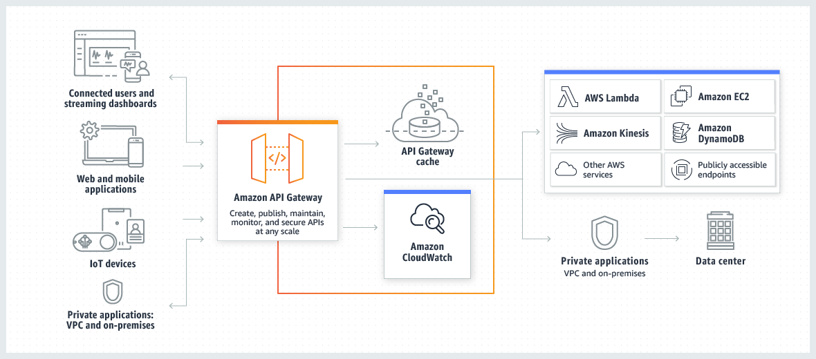
The Serverless Cloud
API & Lambda
Serverless API: No server management, automatic scaling, and functionality from backend
Lambda API: API Gateway sends request to Lambda, Lambda communicates with database and returns response
Integrating the frontend with the backend:
Implement backend
Test API
Connect frontend
Deploy the application
Amazon. (2025). API Gateway architecture. AWS. Retrieved from https://docs.aws.amazon.com/apigateway/latest/developerguide/welcome.html
Notes:
The advantages of using a serverless API are no server management, automatic scaling based on demand, and improved functionality from backend services, such as code running on AWS Lambda. The Lambda API Logic starts with the API Gateway which routes the request to a Lambda function that runs the appropriate logic, communicates with the database, and returns a response. Integrating the frontend with the backend of the application involves using API Gateway endpoints to interact with the Lambda functions, making the backend accessible through HTTP requests. It starts with implementing the backend, then testing the API, and connecting the frontend where you can then deploy the application.

Slide 7
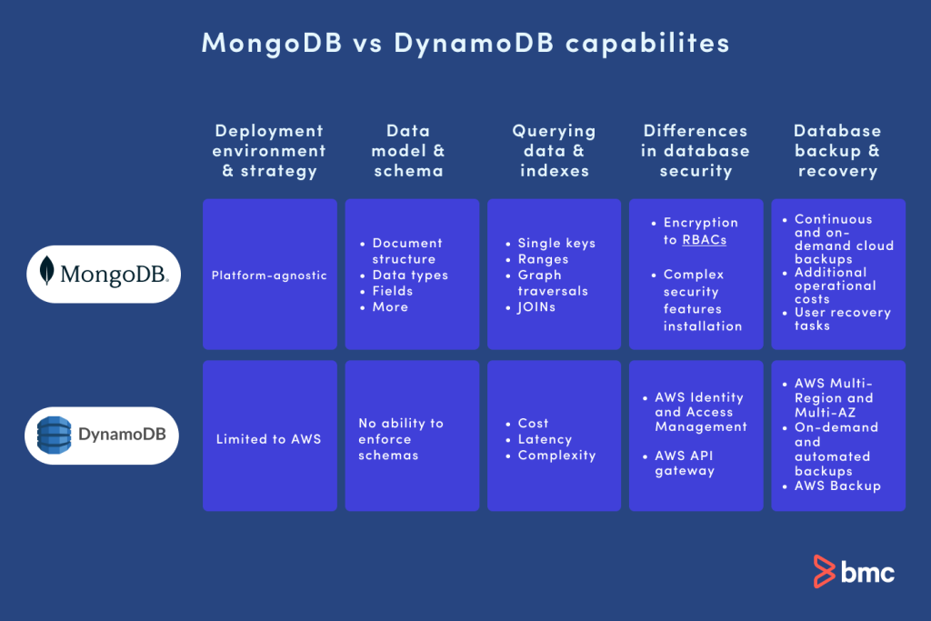
The Serverless Cloud
Database
DynamoDB: Key-value and document-based data stored in JSON format but limited to AWS
MongoDB: Document-based data stored in BSON format that can be used with nearly any platform
Queries performed: CRUD operations
Scripts: JavaScript
Wickramasinghe, S. (2024). Serverless Architectures with AWS Lambda. BNC Software. Retrieved from https://www.bmc.com/blogs/mongodb-vs-dynamodb/
Notes:
DynamoDB is a serverless, NoSQL, fully managed database by Amazon that supports key-value and document data while storing it in JSON format with single-digit millisecond performance at any scale. Meanwhile, MongoDB is a general purpose, document-based distributed NoSQL database that stores data primarily in BSON format with some JSON formatted data. This means that the data in MongoDB is stored in binary whereas DynamoDB stores data in a text file format. DynamoDB was used to perform the CRUD operations, or Create, Read, Update, and Delete which easily allows for access and modification to the data being stored through JavaScript.

Slide 8
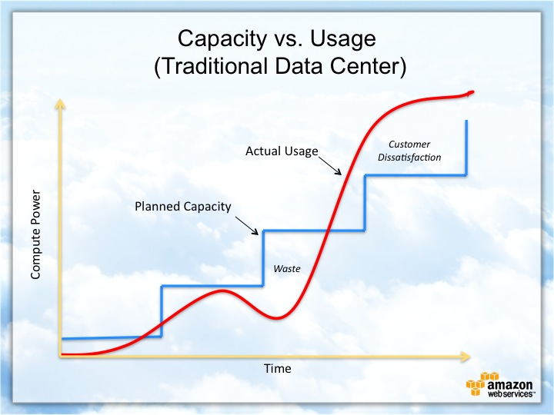
Cloud-Based Development Principles
Elasticity: The ability of a cloud system to scale resources automatically
Pay-for-use model: A pricing model where customers only pay for the resources they use
Notes:
Cloud-based development principles include elasticity and pay-for-use model. Elasticity refers to the ability of a cloud system to scale resources automatically in response to demand changes. A pay-for-use model refers to a pricing model in which customers only pay for the resources they use. These principles work together to allow businesses to optimize both performance and cost

Slide 9
Securing Your Cloud App
Access
Policies
API Security
Unauthorized access is prevented with:
IAM roles
CORS rules
Roles: Define who can access resources
Policies: Determine what actions can be performed on those resources
Custom policies: CRUD operations
Secure the connection between Lambda and API Gateway: MFA and authorization controls
Lambda and DynamoDB: IAM roles and policies
S3 Bucket: Bucket policies, IAM roles, and AWS identity and access management
Notes:
To secure your cloud app there are a few things you need to keep in mind which include unauthorized access, policies, and API security. To prevent unauthorized access, you must implement CORS rules (Cross-Origin-Resource-Sharing) and IAM roles to define identities, for example Lambda functions and users, that can access AWS resources. Additionally, roles define who (or what) can access resources whereas policies determine what actions those identities can perform on those resources. The custom policies created for this project include CRUD operations which are create, read, update, and delete. Furthermore, securing the connection between Lambda and Gateway includes MFA (Mutli-Factor Authentication) and authorization controls. Securing the connection between Lambda and DynamoDB includes IAM roles and policies. Securing the S3 bucket includes employing bucket policies that ensure no unauthorized access can occur, implementing IAM roles to manage temporary credentials for applications/services that need to access S3, and ensuring AWS identity and access management.

Slide 10
Conclusion
Cloud Development:
Serverless
Secure
Automatic scalability
Thank you for your time.
Notes:
Overall, it is clear to see that cloud development is superior to other migration methods due to it being serverless which frees up time for developers to focus on code, secure with easy implementation of various levels of authentication and authorization controls through IAM roles and CORS rules and automatically scales in response to the demand changing through elasticity and the pay-for-use model which ensures that cloud development is both cost-effective and efficient.

